Slide 1
Dynamics and Drivers of Regional Integration in Europe and South Asia:
A Comparative Analysis
Prof. Dr. Riaz Shad
Jean Monnet Chair/HoD
Department of International Relations
National University of Modern Languages

Slide 2
What is Regional Integration?
Regional integration is the process by which two or more nation-states agree to co-operate and work closely together to achieve peace, stability and economic growth.
Regional integration goes beyond cooperation and involves the transfer, sharing or pooling of sovereignty
This co-operation usually begins with economic integration and as it continues, comes to include political integration.
It is achieved through physical and institutional infrastructures.

Slide 3
How to study Regional Integration?
Factors of Regional Integration
Process of Regional Integration
Regional Integration leading to a Platform
Regional Integration leading to an Actor

Slide 5
European Integration vs. Asian Integration
European ‘hard integration’……….implemented through formal political and institutional arrangements; decisions are legally binding
Asian ‘soft integration’…………open integration; market-driven integration; implemented through transnational networks; formal institutions do not exist
Different histories, cultural backgrounds and experiences
How can the relative weakness of formal institutions in Asia be explained? A comparison with the EU suggests two answers: different international norms and domestic state structures in Asia and Europe
US promoted multilateralism in Europe but not in Asia; Asian states lack democratic domestic structures
South Asia as Least Integrated Region in the World
Around the world, trade has played a critical role in reducing poverty. Some of the most successful countries in East Asia, Europe, and North America owe much of their success to strong trade relations with their neighbors. However, South Asian countries have yet to reap the benefits of proximity. Intraregional trade accounts for a little more than 5 percent of South Asia’s total trade, compared with 50 percent in East Asia and the Pacific and 22 percent in Sub-Saharan Africa.

Slide 6
Structural Factors of RI in Europe
Lasting Peace in European Continent
A moral idea; a new European Idea
Desire for European peace required to address the ‘German Problem’
The most important motive behind the movement for European integration is the need to attach Germany permanently to Western Europe, but in such a manner that she cannot dominate it.
Soviet Threat
European integration encouraged by the United States and for many years stimulated by fear of the Soviet Union (USSR).
Socio-economic Factors
WWII caused socio-economic devastation to European nations. Britain, which had been the world’s greatest trading nation in 1914, was now a debtor. Socio-economic recovery was important to regain political legitimacy. This was possible through cooperation and working together.

Slide 7
SOUTH ASIA-THE ENVIRONMENT
South Asia comprises Bangladesh, Bhutan, India, the Maldives, Nepal, Pakistan and Sri Lanka. Afghanistan joined the SAARC in 2005
South Asia is distinctly characterized by complex security issues, multiple inter-state disputes; yet a highly untapped economic potential
The challenges faced by the region are based on deep rooted and historic differences

Slide 8
Constraints for Regional Integration in South Asia
Economic Factors
Market Asymmetry
Market Competitiveness
Less Diverse Market Products
Political Factors
Historical Political Perceptions
Role of Major Powers
Role of Dominant Regional Actor
Role of Leadership.
Role of Institutions.
Social Factors
Socio-Cultural Commonalities
Socio-Cultural Harmony

Slide 9
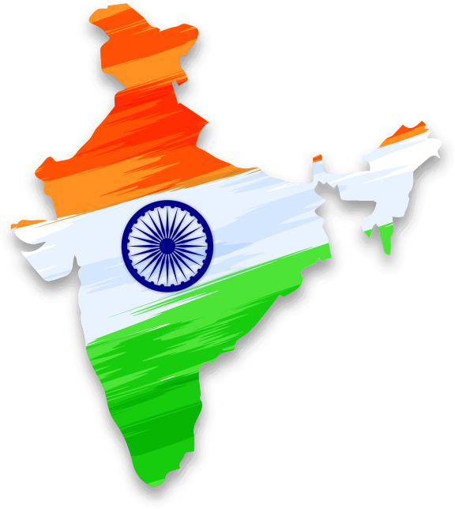
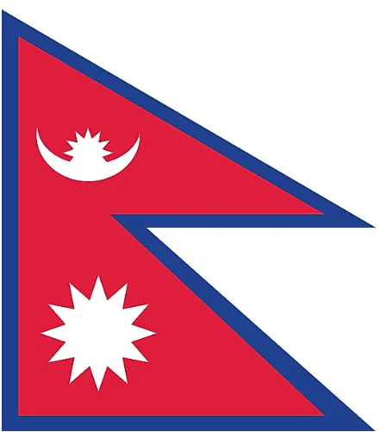
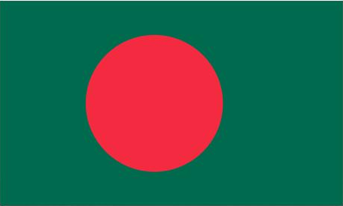
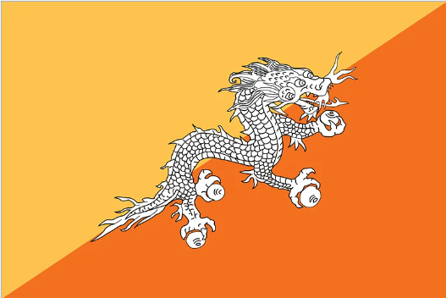
INDIAN HEGEMONIC DESIGNS
India - Pakistan
Kashmir, Siachen Dispute
Sir Creek Dispute
Indus Water Treaty Issues
India - China
Aksai Chin Dispute
Arunanchal Dispute
Ladakh Dispute
India - Nepal Border Dispute of Kalapani & Susta
India Centric Disputes
India - Bangladesh
Land Border Dispute
Sea Border Dispute
India - Srilanka
Dispute over Movement of Rebels & Maritime Issues
India - Bhutan Dispute on Border due to China’s fear and Inda’s concerns
Notes:
India due to its emerging geopolitical relevance, has been pursuing hegemonic designs in the region. In addition to its disputes with China, when we talk of South Asia; India has political disputes almost with all its neighbours in South Asia. This slide presents glimpse of few of these disputes.

Slide 10
MILITARY SPENDING IN SOUTH ASIA - 2022
Country | Military Spending (US$ billions) | World Ranking
India | 76.6 | 3
Pakistan | 11.3 | 31
Bangladesh | 3.80 | 50
Sri Lanka | 2.50 | 69
Nepal | 0.437 | 99
Afghanistan | 0.262 | 118
Source: SIPRI Year Book 2022 & World Population Review 2022
Notes:
Military spending of South Asian countries shown in this slide. India is the 3rd largest country in the world with regard to military spendings.

Slide 11
India’s Regional and Trans Regional Initiatives
Bay of Bengal Initiative for Multi – Sectoral, Technical and Economic Cooperation (BIMSTEC) – 7 countries to include India, Bhutan, Bangladesh, Myanmar, Thailand, Nepal and Sri Lanka.
BBIN – Bangladesh, Bhutan, India and Nepal (countries of Eastern South Asia).
IMEC – India, Middle East, Europe Economic Corridor
SCO
BRICS

