Slide 1
Nature and Scope of Western Economic Sanctions against Russia
Dr Farah Naz
National University of Sciences and Technology, Pakistan
farahnaz@s3h.nust.edu.pk

Slide 2
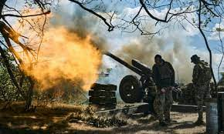
447th day of war
UK promises more weapons
Germany announced additional military aid for Ukraine worth almost $3bn, including tanks, antiaircraft systems and ammunition.
France said it will send dozens of armoured vehicles and light tanks, including the AMX-10RCs fighting vehicles, to Ukraine in the coming weeks.
The European Union must speed up the supply of ammunition to Ukraine as the country’s forces need 1,000 artillery shells every day in the Bakhmut area alone
World Bank says $411bn cost to rebuild war-torn Ukraine (23 March 2023)
2 million homes damaged, more than one in five public health institutions damaged, 650 ambulances damaged or stolen and at least 9,655 civilians confirmed dead, including 461 children
The evaluation expects Kyiv to require $14bn for critical and priority reconstruction as well as recovery investments in 2023 alone.
more than 8 million Ukrainians have registered as refugees in Europe and another 5.3 million have become internally displaced (UNHCR)

Slide 3
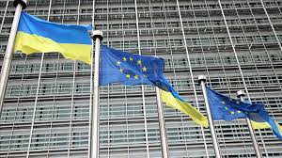
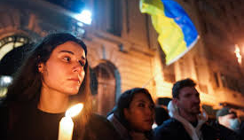
Nature and Scope of the sanctions
Sanctions were imposed on the banking, finance, trade & technology, industries
Rich and influential people close to oligarchs
Energy (oil, gas and coal)
The aim of the economic sanctions
To impose severe consequences on Russia for its actions and to effectively thwart Russian abilities to continue the aggression.
To damage Russian currency

Slide 4
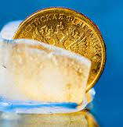
Sanctioned Russian banks that together hold around $1 trillion in assets.
Assets of the Central Bank of Russia worth over 70 billion U.S. dollars were frozen in France as of March 2022, more than in any other country that imposed sanctions in that form.
Furthermore, the Bank of Russia had almost 60 billion U.S. dollars in assets frozen in Japan

Slide 5
Society for Worldwide Interbank Financial telecommunication (SWIFT)China and Russia are working on homegrown alternatives to the SWIFT payment system
China: Cross-Border Interbank Payment System (CIPS)
Russia: System for Transfer of Financial Messages (SPFS)
China withdrawn $2.70 Billion
Japan
Multiple currencies acceptability
1 USD equal 79.51 Russian Ruble

Slide 6
conclusion

